Slide 1


Computer Networks
Lectures (Chapter 5)
Network Layer: Control Plan
Subhan Ullah, PhD
subhan.ullah@nu.edu.pk
BS(Computer Science) Spring-2022

Slide 2
Network layer control plane: our goals
understand principles behind network control plane:
traditional routing algorithms
SDN controllers

Slide 3

Network layer: “control plane” roadmap
introduction
routing protocols
link state
distance vector
Internet Control Message Protocol (already covered…)

Slide 4
Network-layer functions
forwarding: move packets from router’s input to appropriate router output
data plane
routing: determine route taken by packets from source to destination
control plane
Two approaches to structuring network control plane:
per-router control (traditional)
logically centralized control (software defined networking)

Slide 5

Per-router control plane
Individual routing algorithm components in each and every router interact in the control plane
Routing
Algorithm
control
plane
data
plane
values in arriving
packet header
0111
1
3
2

Slide 6
Software-Defined Networking (SDN) control plane
Remote controller computes, installs forwarding tables in routers
Remote Controller
control
plane
data
plane
CA
CA
CA
CA
CA
values in arriving
packet header
0111
1
3
2

Slide 7
Network layer: “control plane” roadmap
introduction
routing protocols
link state
distance vector
intra-ISP routing: OSPF
routing among ISPs: BGP
SDN control plane
Internet Control Message Protocol
network management, configuration
SNMP
NETCONF/YANG

Slide 8








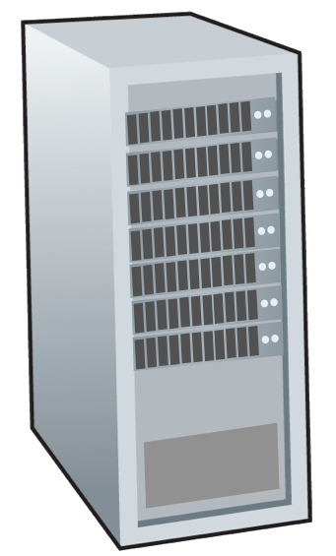







Routing protocols
mobile network
Routing protocol goal: determine “good” paths (equivalently, routes), from sending hosts to receiving host, through network of routers
path: sequence of routers packets traverse from given initial source host to final destination host
“good”: least “cost”, “fastest”, “least congested”
routing: a “top-10” networking challenge!
national or global ISP
application
transport
network
link
physical
network
link
physical
network
link
physical
network
link
physical
network
link
physical
network
link
physical
datacenter
network
application
transport
network
link
physical
enterprise
network

Slide 9
Graph abstraction: link costs
5
c_{a,b}: cost of direct link connecting a and b
e.g., c_{w,z} = 5, c_{u,z} = ∞
cost defined by network operator: could always be 1, or inversely related to bandwidth, or directly related to congestion
v
3
w
2
5
u
2
1
z
3
1
2
x
y
1
graph: G = (N,E)
N: set of routers = { u, v, w, x, y, z }
E: set of links ={ (u,v), (u,x), (v,x), (v,w), (x,w), (x,y), (w,y), (w,z), (y,z) }
aside: graph abstraction is useful in other network contexts, e.g., P2P, where N is set of peers and E is set of TCP connections

Slide 10
Routing algorithm classification
global: all routers have complete topology, link cost info
“link state” algorithms
dynamic: routes change more quickly
periodic updates or in response to link cost changes
How fast do routes change?
static: routes change slowly over time
decentralized: iterative process of computation, exchange of info with neighbors
routers initially only know link costs to attached neighbors
“distance vector” algorithms
global or decentralized information?

Slide 11
Network layer: “control plane” roadmap
introduction
routing protocols
link state
distance vector
intra-ISP routing: OSPF
routing among ISPs: BGP
SDN control plane
Internet Control Message Protocol
network management, configuration
SNMP
NETCONF/YANG

Slide 12
Dijkstra’s link-state routing algorithm
centralized: network topology, link costs known to all nodes
accomplished via “link state broadcast”
all nodes have same info
computes least cost paths from one node (“source”) to all other nodes
gives forwarding table for that node
iterative: after k iterations, know least cost path to k destinations
notation
c_{x,y}: direct link cost from node x to y; = ∞ if not direct neighbors
D(v): current estimate of cost of least-cost-path from source to destination v
p(v): predecessor node along path from source to v
N': set of nodes whose least-cost-path definitively known

Slide 13
Dijkstra’s link-state routing algorithm
1 Initialization:
2 N' = {u} /* compute least cost path from u to all other nodes */
3 for all nodes a
4 if a adjacent to u /* u initially knows direct-path-cost only to direct neighbors */
5 then D(a) = c_{u,a} /* but may not be minimum cost! */
6 else D(a) = ∞
7
8 Loop
9
10
11
12
13
14
15 until all nodes in N'
find a not in N' such that D(a) is a minimum
add a to N'
update D(b) for all b adjacent to a and not in N' :
D(b) = min ( D(b), D(a) + c_{a,b} )
/* new least-path-cost to b is either old least-cost-path to b or known
least-cost-path to a plus direct-cost from a to b */

Slide 14
Dijkstra’s algorithm: an example
v
w
x
y
z
Step
0
1
2
3
4
5
N'
D(v),p(v)
D(w),p(w)
D(x),p(x)
D(y),p(y)
D(z),p(z)
u
2,u
5,u
1,u
∞
∞
ux
2,u
4,x
2,x
∞
uxy
2,u
3,y
4,y
uxyv
3,y
4,y
uxyvw
4,y
uxyvwz
Initialization (step 0): For all a: if a adjacent to then D(a) = c_{u,a}
5
find a not in N' such that D(a) is a minimum
add a to N'
update D(b) for all b adjacent to a and not in N' :
D(b) = min ( D(b), D(a) + c_{a,b} )
v
3
w
2
5
u
2
1
z
3
1
2
x
y
1
Notes:
Steps for row 0(Identification) and 1 (update).
D(v) = min ( D(v), D(x) + c_{x,v} ) =min(2, 1+2) = 2
D(w) = min ( D(w), D(x) + c_{x,w} ) = min (5, 1+3) = 4
D(y) = min ( D(y), D(x) + c_{x,y} ) = min (inf, 1+1) =2
Steps for row 2(identification) and 3(update).
D(w) = min ( D(w), D(y) + c_{y,w} ) = min (4, 2+1) = 3
D(z) = min ( D(z), D(y) + c_{y,z} ) = min (inf, 2+2) =4
Steps for 4(identification) and 5(update).
D(w) = min(D(w), D(v)+ c_{v,w} ) = min (3, 2+3) = 3
D(z) = min ( D(z), D(w) + c_{w,z} ) = min (4, 3+5) =4

Slide 15
Dijkstra’s algorithm: an example
5
v
3
w
2
5
u
2
1
z
3
1
2
D(w),p(w)
5,u
4,x
3,y
3,y
x
y
1
resulting least-cost-path tree from u:
resulting forwarding table in u:
v
w
destination
outgoing link
v
x
y
w
x
(u,v)
(u,x)
(u,x)
(u,x)
(u,x)
route from u to v directly
u
z
x
route from u to all other destinations via x
y

Slide 16
Dijkstra’s algorithm: another example
v
w
x
y
z
x
D(v),
p(v)
D(w),
p(w)
D(x),
p(x)
D(y),
p(y)
D(z),
p(z)
9
Step
N'
0
u
7,u
3,u
5,u
∞
∞
5
7
4
1
uw
6,w
5,u
11,w
∞
8
2
uwx
6,w
11,w
14,x
u
3
w
y
z
2
3
uwxv
10,v
14,x
3
4
uwxvy
12,y
7
4
5
uwxvyz
v
notes:
construct least-cost-path tree by tracing predecessor nodes
ties can exist (can be broken arbitrarily)

Slide 17
Dijkstra’s algorithm: discussion
algorithm complexity: n nodes
each of n iteration: need to check all nodes, w, not in N
n(n+1)/2 comparisons: O(n²) complexity
more efficient implementations possible: O(nlogn)
message complexity:
each router must broadcast its link state information to other n routers
efficient (and interesting!) broadcast algorithms: O(n) link crossings to disseminate a broadcast message from one source
each router’s message crosses O(n) links: overall message complexity: O(n²)

Slide 18
Dijkstra’s algorithm: oscillations possible
when link costs depend on traffic volume, route oscillations possible
sample scenario:
routing to destination a, traffic entering at d, c, e with rates 1, e (<1), 1
link costs are directional, and volume-dependent
a
a
a
a
1
1+e
2+e
0
0
2+e
2+e
0
d
b
d
1
b
d
b
d
b
0
0
1+e
0
0
1+e
1
1
0
e
1
0
c
0
1
1
1
c
1+e
1
1
0
0
1
c
1
c
e
e
e
e
given these costs,
find new routing….
resulting in new costs
given these costs,
find new routing….
resulting in new costs
given these costs,
find new routing….
resulting in new costs
initially
Notes:
Figure shows a simple network topology where link costs are equal to the load carried on the link, for example, reflecting the delay that would be experienced. In this example, link costs are not symmetric; that is, c(u,v) equals c(v,u) only if the load carried on both directions on the link (u,v) is the same.
When the LS algorithm is next run, node C determines (based on the link costs shown in Figure 4.2-2a) that the clockwise path to A has a cost of 1, while the counterclockwise path to A (which it had been using) has a cost of 1+e. Hence C's least cost path to A is now clockwise. Similarly, B determines that its new least cost path to A is also clockwise, resulting in the routing and resulting path costs shown in Figure 4.2-2b. When the LS algorithm is run next, nodes B, C and D all detect that a zero cost path to A in the counterclockwise direction and all route their traffic to the counterclockwise routes. The next time the LS algorithm is run, B, C, and D all then route their traffic to the clockwise routes.

Slide 19
Oscillations
In general, any algorithm that uses a congestion or delay-based link metric can have such oscillations.
What can be done?
Possible Solution - link costs not depend on the amount of traffic carried
Acceptable?
Another solution is to ensure that not all routers run the LS algorithm at the same time
Interestingly, researchers have found that routers in the Internet can self-synchronize among themselves
One way to avoid such self- synchronization is for each router to randomize the time it sends out a link advertisement
Notes:
What can be done to prevent such oscillations in the LS algorithm? One solution would be to mandate that link costs not depend on the amount of traffic carried -- an unacceptable solution since one goal of routing is to avoid highly congested (e.g., high delay) links. Another solution is to insure that all routers do not run the LS algorithm at the same time. This seems a more reasonable solution, since we would hope that even if routers run the LS algorithm with the same periodicity, the execution instants of the algorithm would not be the same at each node.
This seems a more reasonable solution, since we would hope that even if routers ran the LS algorithm with the same periodicity, the execution instance of the algorithm would not be the same at each node.
even though they initially execute the algorithm with the same period but at different instants of time, the algorithm execution instance can eventually become, and remain, synchronized at the routers

Slide 20
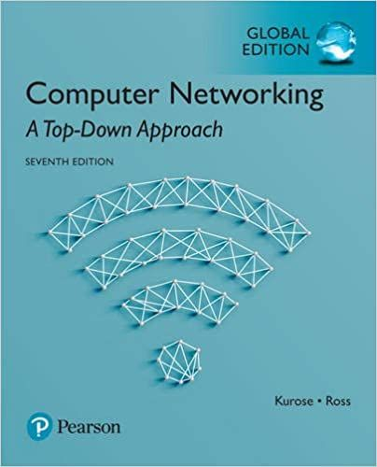

Thank You All
☺
?
A note on the origin of these ppt slides:
All material copyright 1996-2020 J.F Kurose and K.W. Ross, All Rights Reserved
These slides are freely provided by the book authors and it represents a lot of work on their part. We would like to thank J.F Kurose and K.W. Ross.
Network Layer: Control plan: 3-150
Notes:
Section F and G ended

